Slide 1
ONLINE BOOK STORE
By:
Rohitha Sai Alla(700734780)
Divya Nandamuri(700724834)

Slide 2
Introduction
Tracking and maintaining information about books of a book store on paper might be a difficult task to the owner.
Also the customer need not search the whole store to find the desired one.
They can login to the application and check the details.
Hence making the owner and the customer’s work easier.
Also customer can buy the book online.

Slide 3





Technologies
Stack details:
Front-end: Angular
Back-end: Node
Database: Mongodb
Tools:
Mongodb compass
Visual Studio

Slide 4
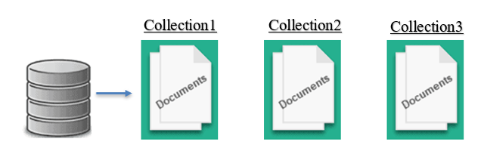
Database Model

Slide 5
Collections used
Users
Orders
Books

Slide 6
Features
Register
Login
Roles:
Employee
Customer
Employee Features:
Add book
Delete book
Edit book
Customer Features:
View book
Buy book
Review
Return

Slide 7
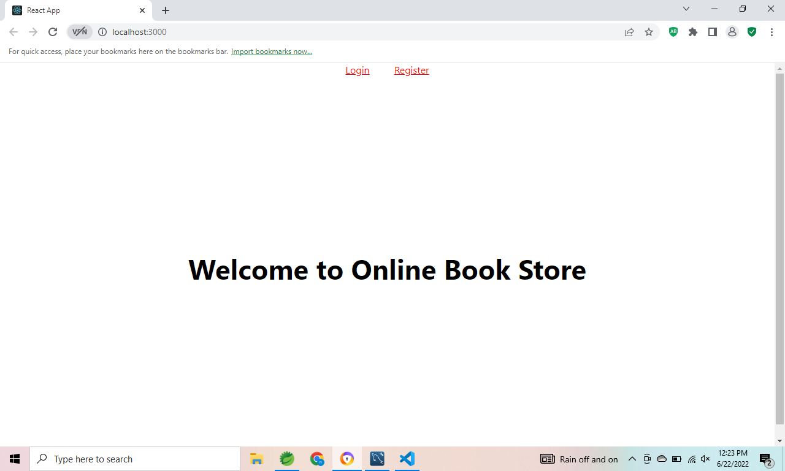
Home Page

Slide 8
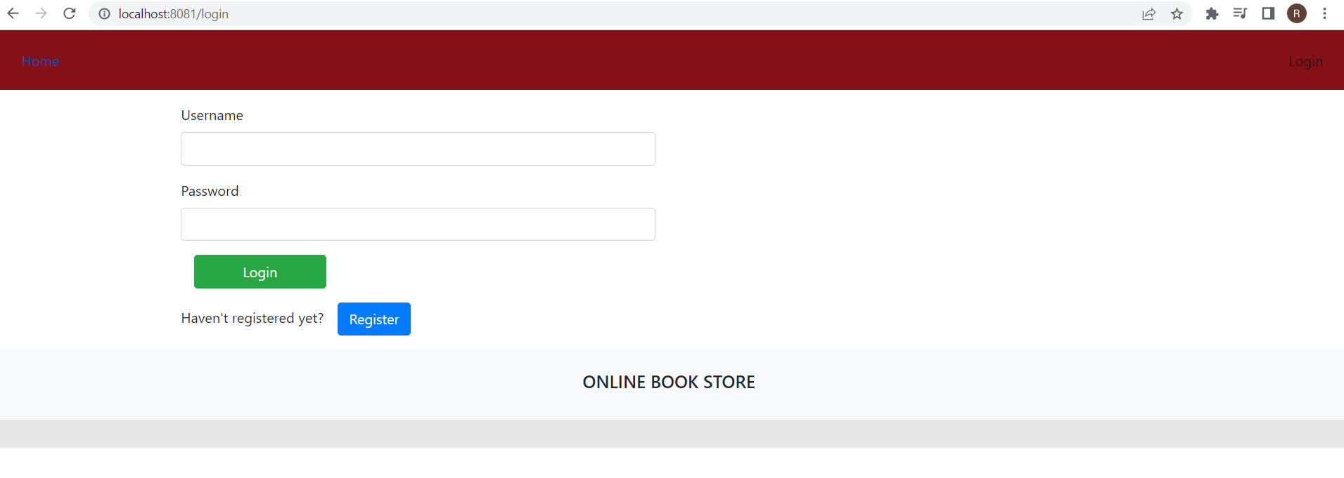
Login Page

Slide 9
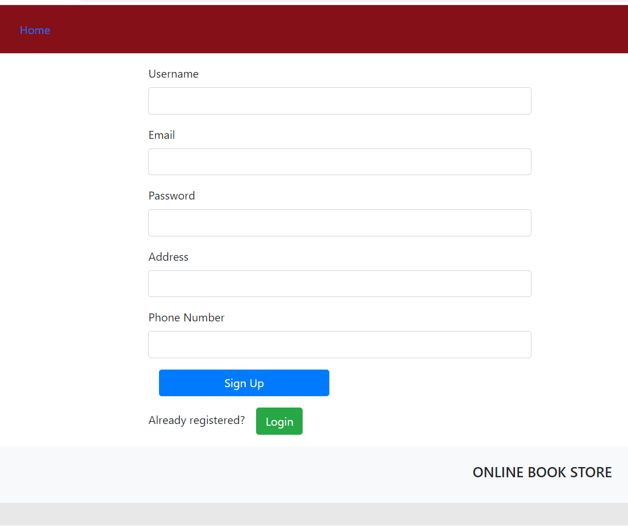
Register

Slide 10
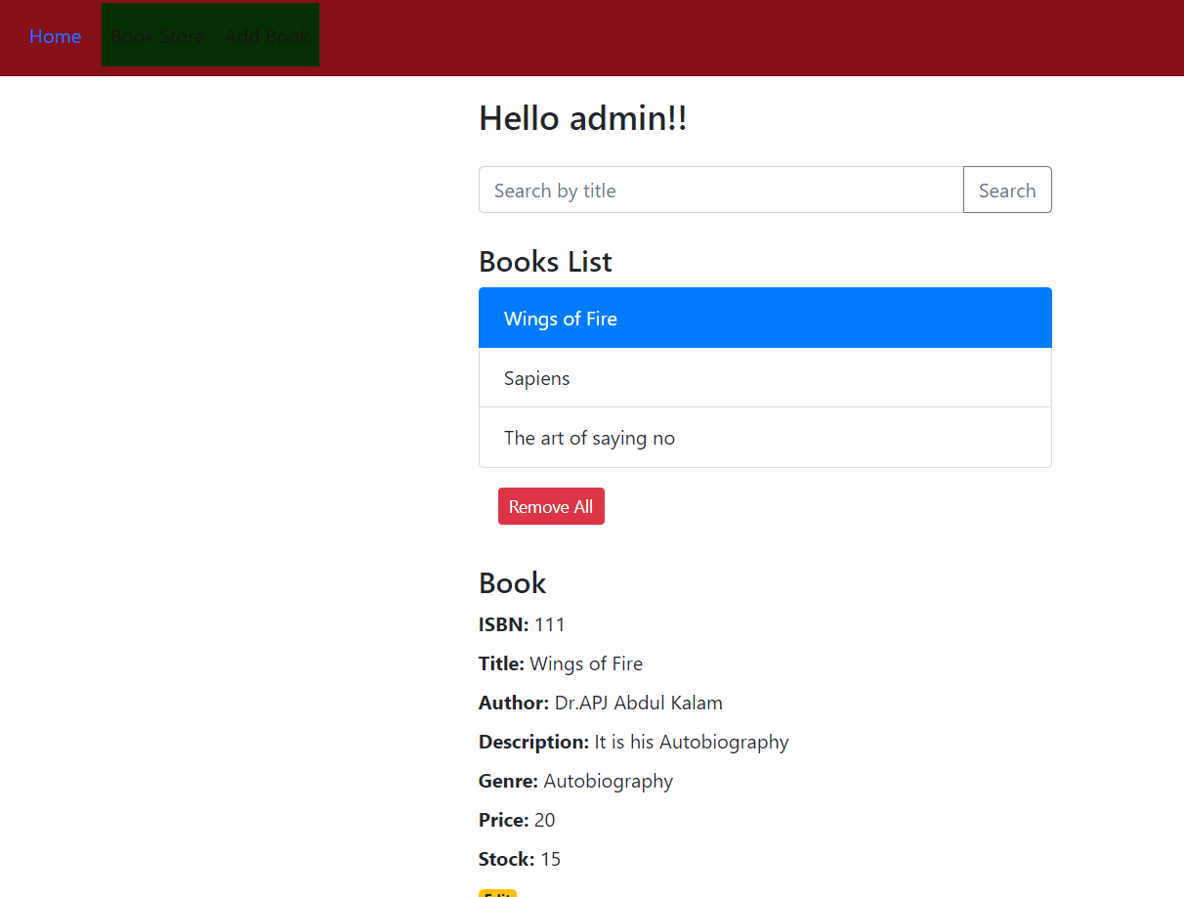
Employee home page

Slide 11
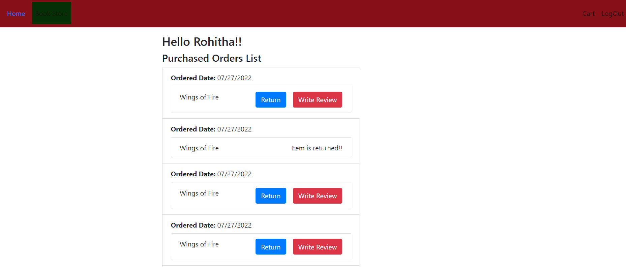
Customer homepage

Slide 12
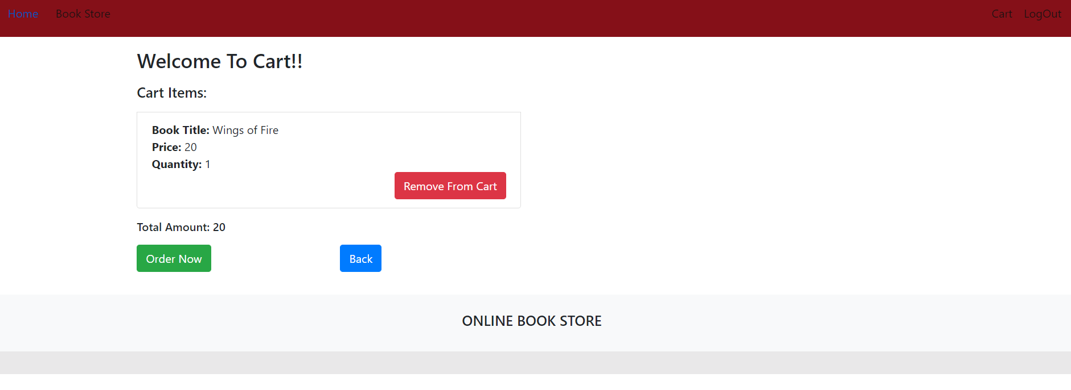
Order page

Slide 13
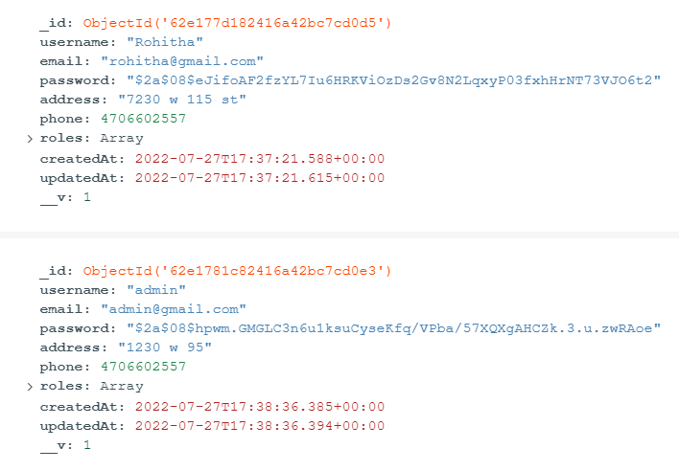
Users Collection

Slide 14
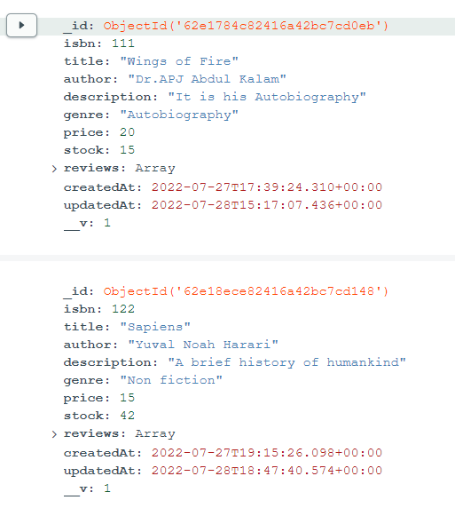
Books Collection

Slide 15
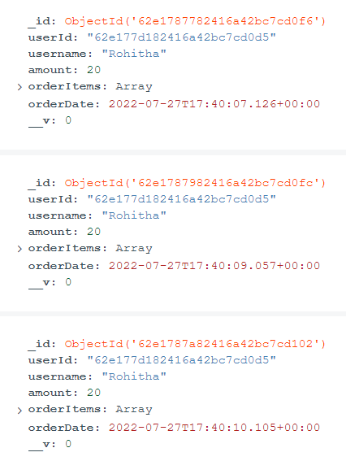
Orders Collection

Slide 16
THANK YOU

